Slide 1
Vector stores / database

Slide 2

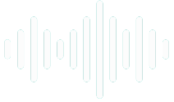
Document
Loader
Text
Splitter
Text chunks
PDF
Loaded PDF
embedding model
Embeddings
Vector Database
embedding model
Retriever
+
Final output
user query
Embeddings
Semantic search
Result chunks + user query
LLM

Slide 3
What are Vector Stores/Databases in LangChain?
In LangChain, a Vector Store (or Vector Database) is a specialized database designed to efficiently store, manage, and query vector embeddings. These embeddings are high-dimensional numerical representations of text, images, audio, or any other data type, where the numerical proximity of vectors implies semantic similarity between the original data points.
Think of it as a smart index for your data's meaning. Instead of searching by keywords or structured fields, you search by the meaning of your query.
Key characteristics:
Stores Embeddings: Its primary content is vectors, usually generated by embedding models (like OpenAI's text-embedding-ada-002, Google's text-embedding-004, etc.).
Similarity Search: Its core functionality is to perform similarity searches (e.g., nearest neighbor search, cosine similarity search). Given a query embedding, it quickly finds the stored embeddings that are numerically "closest" to it.
Metadata Storage: Often stores associated metadata alongside the vectors (e.g., the original text chunk, source URL, author, date) to provide context for the retrieved results.
Scalability: Designed to handle billions of vectors and perform searches with low latency.

Slide 4
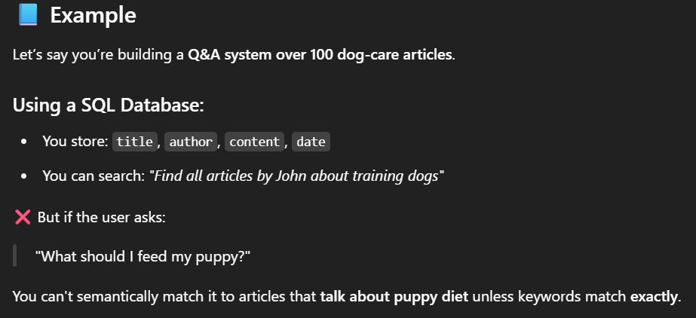
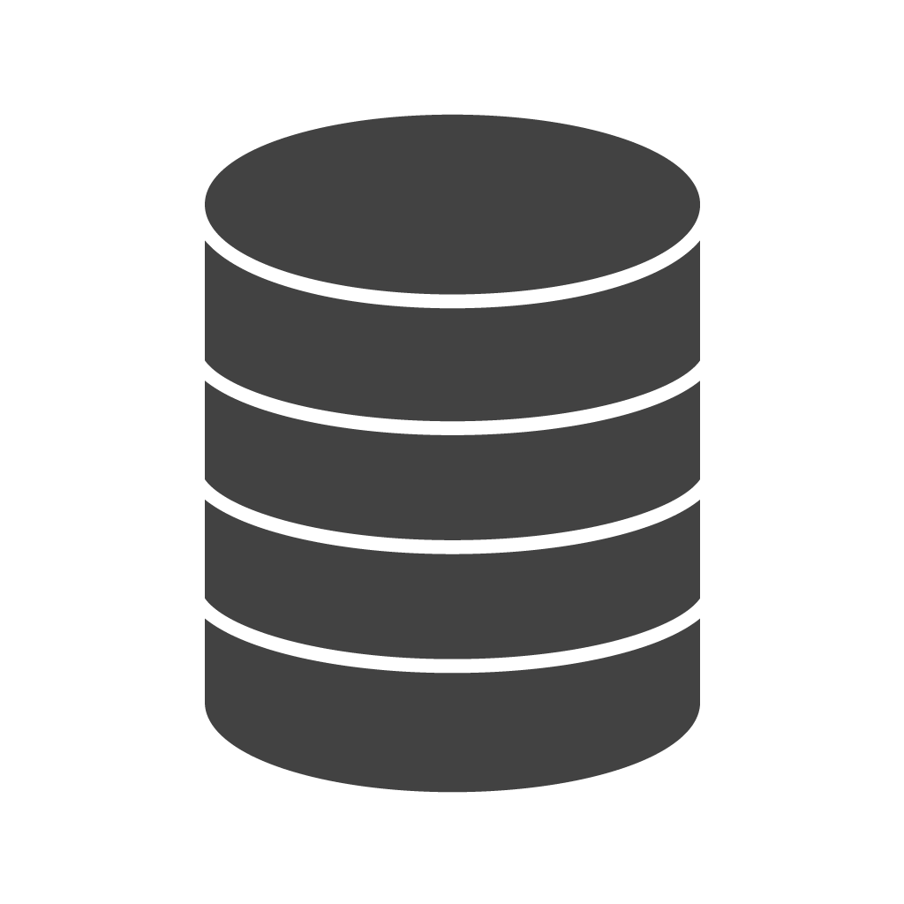
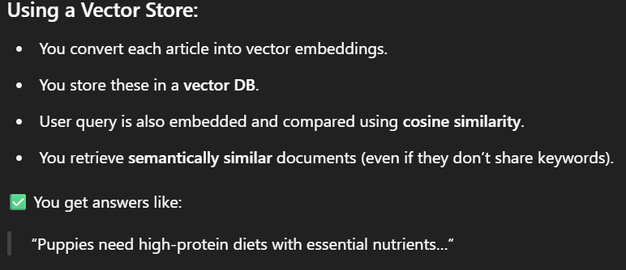
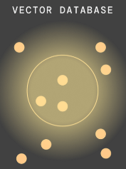

Slide 5
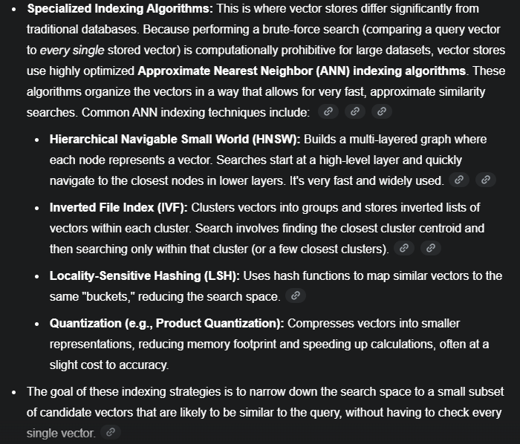

Slide 6
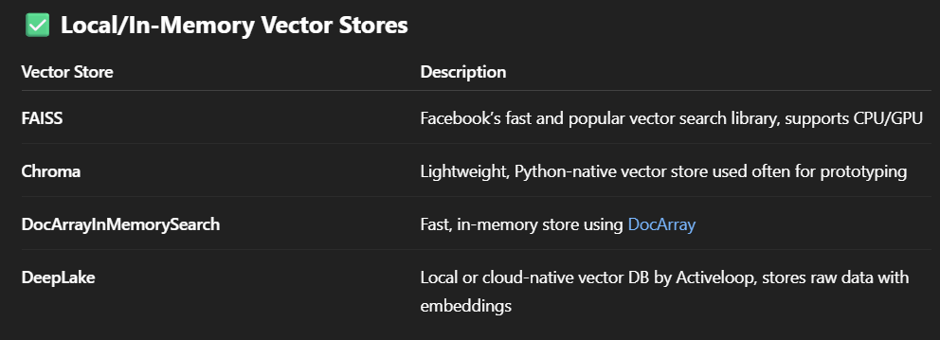
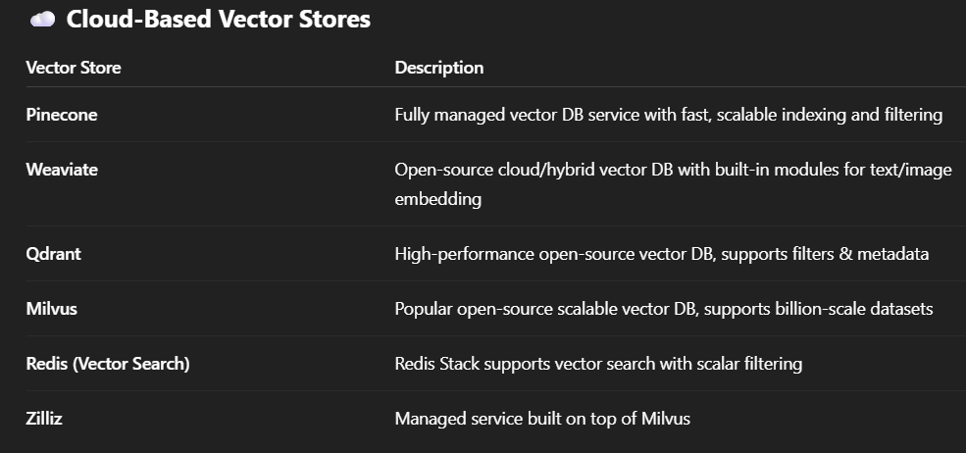
https://python.langchain.com/docs/integrations/vectorstores/

